Slide 1
Аритметични оператори
if оператор
Списъци
if a % 3 == 0:
print (“Divisible by 3”)
elif a % 4 == 0:
print (“Divisible by 4”)
else:
print (“Div by none”)
a = [1, 2, 3, 5, 8]
a[2]
a[2:4]
a.append(15)
if 7 not in a:
print (“7 not here”)
+ | - | * | / | ** | % | //
Сравнение
< | > | <= | >= | == | !=
for цикъл
Графики
Променливи
а = 2
b = 3
b += 1
c = a + b
print (“The sum is “, c)
a = 173
is_prime = True
for i in range(2, a):
if a % i == 0:
is_prime = False
x = [1,2,3,4]
y = [0.2, 0.3, 0.4, 0.8]
plt.plot(x, y)
plt.show()
Масиви
Стрингове и събстрингове
while цикъл
x = np.array([[1,2,3],
[4,0,1]])
sub_x = x[0:1, 1:2]
plt.imshow(x)
plt.show()
seq = “GGGGAAGGGG”
length = len(seq)
loc = seq.find(“AA”)
substr = seq[4:6]
concat = seq[:3] + seq[-3:]
a = 173
is_prime = True
i = 2
while i < a:
if a % i == 0:
is_prime = False
i += 1

Slide 2
fruits = ["apple", "banana", "cherry", "kiwi", "mango"] newlist = [] for x in fruits: if "a" in x: newlist.append(x) print(newlist)

Slide 3
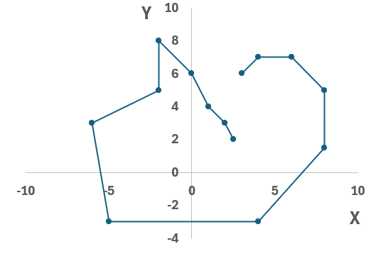

Slide 4
# input data
# define the empty list
# Iterate over the input coordinates
# Take the coordinates of the current point
# Take the coordinates of the second point
# Calculate the distance between the points
# Append to the list
# Show the result

